Slide 1

Module Twelve: Heap
CIS 311 – Prof. C. R. Johnson

Slide 2
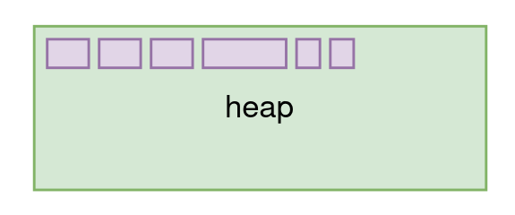
Glibc heap allocator
Used to dynamically allocate/release memory
malloc(), free()
History: dlmalloc → ptmalloc → glibc malloc

Slide 3
Chunks
Fundamental unit of heap memory
Aligned on 16-bytes (64-bit systems)
Metadata above/below data

Slide 4
Bins
Linked lists of free’d chunks
Fast bins
Small bins
Large bins
Unsorted bin
Tcache bins

Slide 5
Arena
All heap memory
Main heap memory region
Additional mmap()’ed regions
Each thread has it’s own arena

Slide 6
Overall structure
A process has one or more threads
Each thread has an arena
Each arena has many bins
Each bin holds zero or more free’d chunks

Slide 7
Allocation
When you call malloc() a chunk is carved from the top chunk at the top of the heap

Slide 8
Deallocation
When you call free() the chunk is added to one of the bins (linked lists) to be reused by future malloc()s

Slide 9
Chunk metadata
Total chunk size (with metadata) is always aligned to 16-bytes
Last 3 (of 4) unused bits describe
A: This chunk is from another arena
M: This chunk was created with mmap
P: The previous chunk is in-use
Example
Chunk size = 0x0000000000000021
Actual Size = 0x20
AMP = ...0001

Slide 10
Allocation example
a = malloc(16);
b = malloc(16);
c = malloc(16);

Slide 11
Free chunk
Free chunks will have forward (and maybe backward) pointers written in their data region
Depends on bin
Fastbins: single linked
Small: double linked
Large: double linked
Unsorted: double linked
Tcache: single linked

Slide 12
Deallocation example
free(a);
free(b);
free(c);

Slide 13
malloc() selection strategy
If size allows, first check tcache bins
If size allows, next check fastbins
Check the unsorted bin
Check small or large bins, depending on size
Allocate a new chunk
Carve off a piece of top chunk
Or mmap() more memory

Slide 14
free() binning strategy
When the chunk is free’d, it will go in...
Tcache: if size matches, and not full (7)
Fastbins: if size matches
Unsorted bin: if neither tcache nor fastbin
In the future, when glibc decides
Chunks may be moved from unsorted to small/large bins
Chunks may be coalesced with adjacent free chunks

Slide 15
GDB / GEF heap commands
Show all arenas
heap arenas
Show all bins and their contents
heap bins
Show all chunks
heap chunks
View a specific chunk
heap chunk <address>
View region of raw memory (Ex: 20 8-byte value)
x/20gx <address>

Slide 16
Heap overflows
By far the simplest form of heap exploitation
Overflow one chunk into another
No return addresses here :(
But also no stack cookies!
What can we overwrite?

Slide 17
Heap Grooming
Influence heap state such that chunks are allocated in a desirable order or location
Real world example: https://devco.re/blog/2018/03/06/exim-off-by-one-RCE-exploiting-CVE-2018-6789-en/

Slide 18
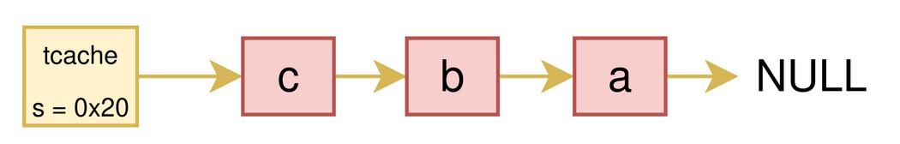
Tcache poisoning
Recall
Each tcache bin is a single linked list of free’d chunks
Each free’d chunk contains a pointer to the next element
Assume we have found a use-after-free bug...

Slide 19
Tcache poisoning
By overwriting the “next” pointer in the free’d chunk, we can add arbitrary items to the list!
Future malloc() calls will “allocate” the pointer which we specified

Slide 20
Tcache poisoning steps
Allocate two chunks a and b of size s
Free a, free b
Tcache <size=s>: b → a → null
Use UaF vuln to overwrite b’s next pointer with target address t
Tcache <size=s>: b → t
Allocate chunk of size s again
malloc() returns the b chunk, discard
Allocate chunk of size s again
malloc() should return our arbitrary target address!

Slide 21
Dupping and Overlapping
Fastbin dup
Useful for exploiting double free vulnerabilities
Overlapping chunks
Useful for exploiting off-by-one vulnerabilities
e.g. one byte heap overflows

Slide 22
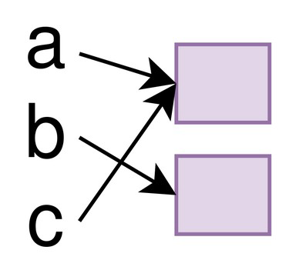
Fastbin dup
Goal
Trick malloc() into returning the same chunk twice for separate allocations.
Assumptions
We have a double-free vulnerability
We can allocate/free somewhat arbitrarily

Slide 23
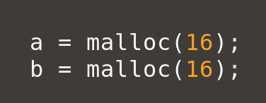
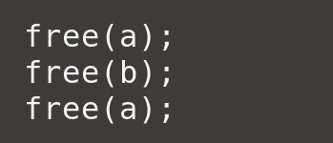
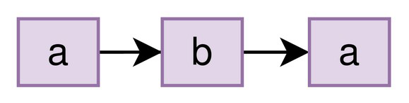
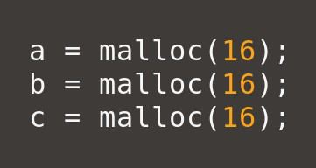
Fastbin dup
Step 1: Allocate two chunks, a and b
Step 2: Free a, b, then a again
Freelist now contains:
Step 3: Allocate three chunks, a, b, c
Will be served from the freelist
Both a and c will be the same chunk!

Slide 24
Limitations
This only works if we free another chunk in between the one we double-free.
free(a); free(a); CRASH
free(a); free(b); free(a); No crash!
This only works with the fastbins
If free() would place a chunk on the tcache twice, the program will crash

Slide 25
Working around the tcache
Allocate 9 chunks
7 will be used to fill the tcache
2 will go in fastbins, for the exploit
Free 10 chunks. 0, 1, 2, 3, 4, 5, 6, 7, 8, 7 ← double-free!
0,1,2,3,4,5,6, ... will fill the tcache
…, 7,8,7 will end up in the fastbin
Allocate 7 chunks
Will be served from the tcache, discard these
Allocate 3 more chunks
We will get 7,8,7 back from the fastbin!

Slide 26
Overlapping chunks
Goal
Trick malloc() into allocating a chunk which overlaps another chunk
Assumptions
We have a one-byte heap overflow
We can allocate/free somewhat arbitrarily

Slide 27
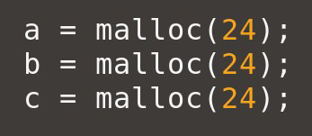
Overlapping chunks
Step 1: Allocate three chunks, a, b, c
Choose a size that ensures the data is contiguous with the next chunk’s metadata! 24, 56, 120 etc (2^n - 8)

Slide 28
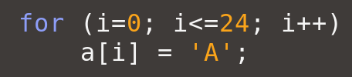
Overlapping chunks
Step 1: Allocate three chunks, a, b, c
Step 2: Overflow a, changing b’s size!
Increase b’s size to overlap c

Slide 29

Overlapping chunks
Step 1: Allocate three chunks, a, b, c
Step 2: Overflow a, changing b’s size!
Step 3: Free b, adding it to the freelist
Will be binned based on invalid size!

Slide 30

Overlapping chunks
Step 1: Allocate three chunks, a, b, c
Step 2: Overflow a, changing b’s size!
Step 3: Free b, adding it to the freelist
Step 4: Allocate new chunk of that size
New b chunk will overlap c chunk! :)

